Slide 1

Ch4 Image To Image Translation

Slide 2
Content
Conditional GANs
Image translation with pix2pix
Unpaired image translation with Cycle GAN
Bicycle GAN

Slide 3
GANs Types
Vanilla GAN
Conditional Gan (CGAN)
Deep Convolutional GAN (DCGAN)
Cycle GAN
Generative Adversarial Text to Image Synthesis
Style GAN
Super Resolution GAN (SRGAN)

Slide 4
What is a Conditional GAN?
the generator and discriminator of the original GAN model are conditioned during the training on external information. This information could be a class label or data from other modalities.
The idea is straightforward. Both generator and discriminator are fed a class label y and conditioned on it, as shown in the above figures. All other components are exactly what you see in a typical Generative Adversarial Networks framework, this being more of an architectural modification.
Notes:
Paper link :https://arxiv.org/pdf/1411.1784.pdf

Slide 5
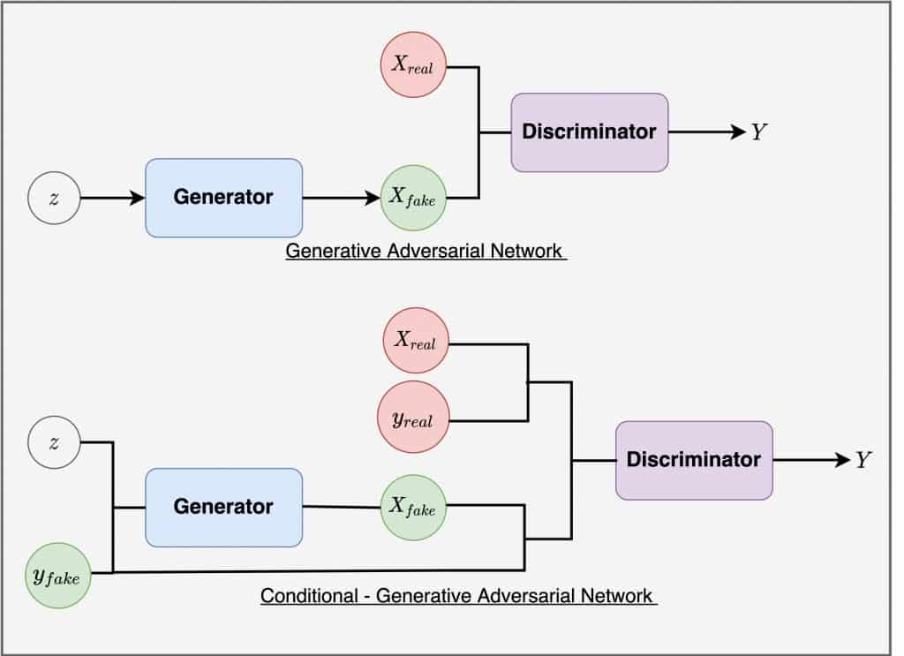

Slide 6
Purpose of Conditional Generator
Ordinarily, the generator needs a noise vector to generate a sample. In a conditional generation, however, it also needs auxiliary information that tells the generator which class sample to produce.
Let’s call the conditioning label y. The Generator uses the noise vector z and the label y to synthesize a fake example G(z, y) = x|y (x conditioned on y, where x is the generated fake example). This fake example aims to fool the discriminator by looking as similar as possible to a real example for the given label.

Slide 7
Purpose of Conditional Generator ..
Now, it is not enough for the Generator to produce realistic-looking data; it is equally important that the generated examples also match the label. So, if a particular class label 1 is passed to the Generator, it should produce a handwritten image 1. You can thus clearly see that the Conditional Generator now shoulders a lot more responsibility than the vanilla GAN or DCGAN.
Once the Generator is fully trained, you can specify what example you want the Conditional Generator to now produce by simply passing it the desired label.

Slide 8
Purpose of Conditional Discriminator
The Discriminator is fed both real and fake examples with labels. It learns to not just recognize real data from fake, but also zeroes onto matching pairs. A pair is matching when the image has a correct label assigned to it. The Discriminator finally outputs a probability indicating the input is real or fake. Its goal is to learn to:
Accept all real sample label pairs.
Reject all fake sample label pairs (the sample matches the label ).
Also, reject all fake samples if the corresponding labels do not match.
For example, the Discriminator should learn to reject:
The pair in which the generated image is 1, but the label was 2, regardless of the example being real or fake. The reason being it does not match the given label.
All image-label pairs in which the image is fake, even if the label matches the image.

Slide 9
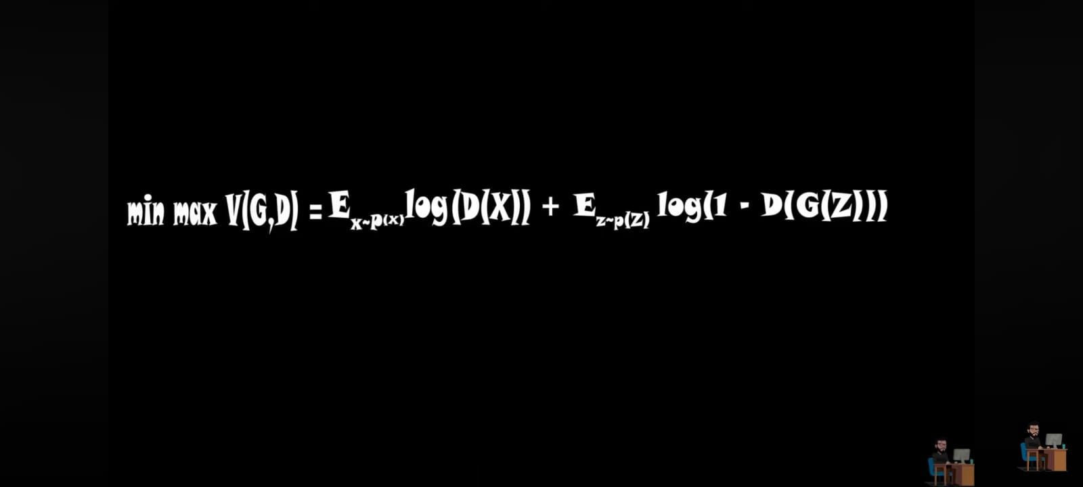
GAN Loss Function

Slide 10
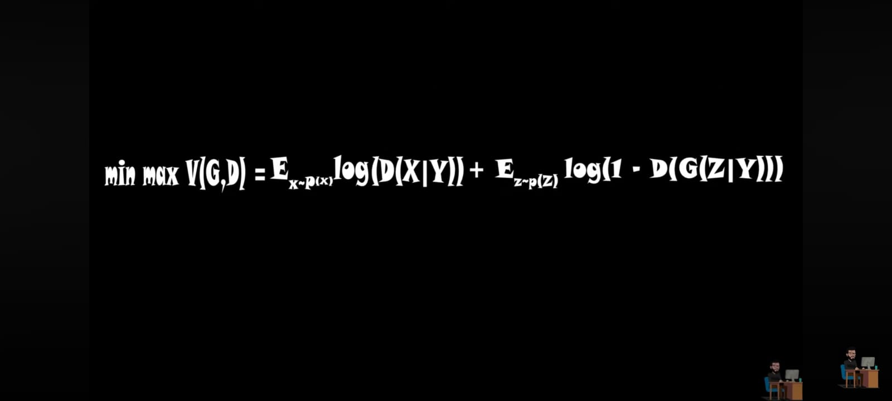
CGAN Loss Function

Slide 11
What is a Pix2Pix GAN?
Guess what inspired Pix2Pix. It was the Conditional GAN (CGAN), which again was an extension of the DCGAN architecture.
The main idea behind Pix2Pix is to train a generator model to learn the mapping between input images from one domain (such as sketches, edges, or labels) to output images in another domain (such as photographs or realistic renderings). This is achieved by pairing input images with their corresponding target images during training.
Notes:
Paper Link :https://arxiv.org/pdf/1611.07004.pdf

Slide 12
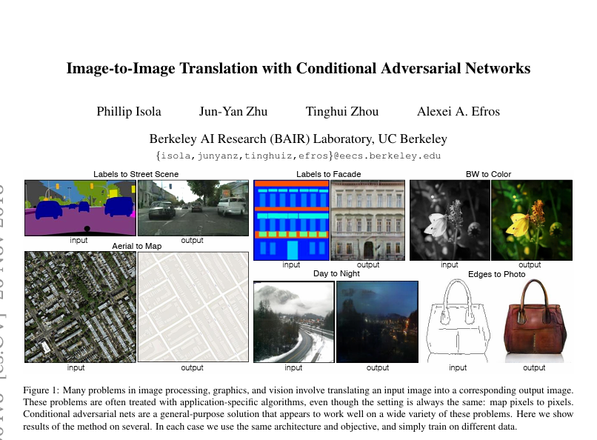

Slide 13
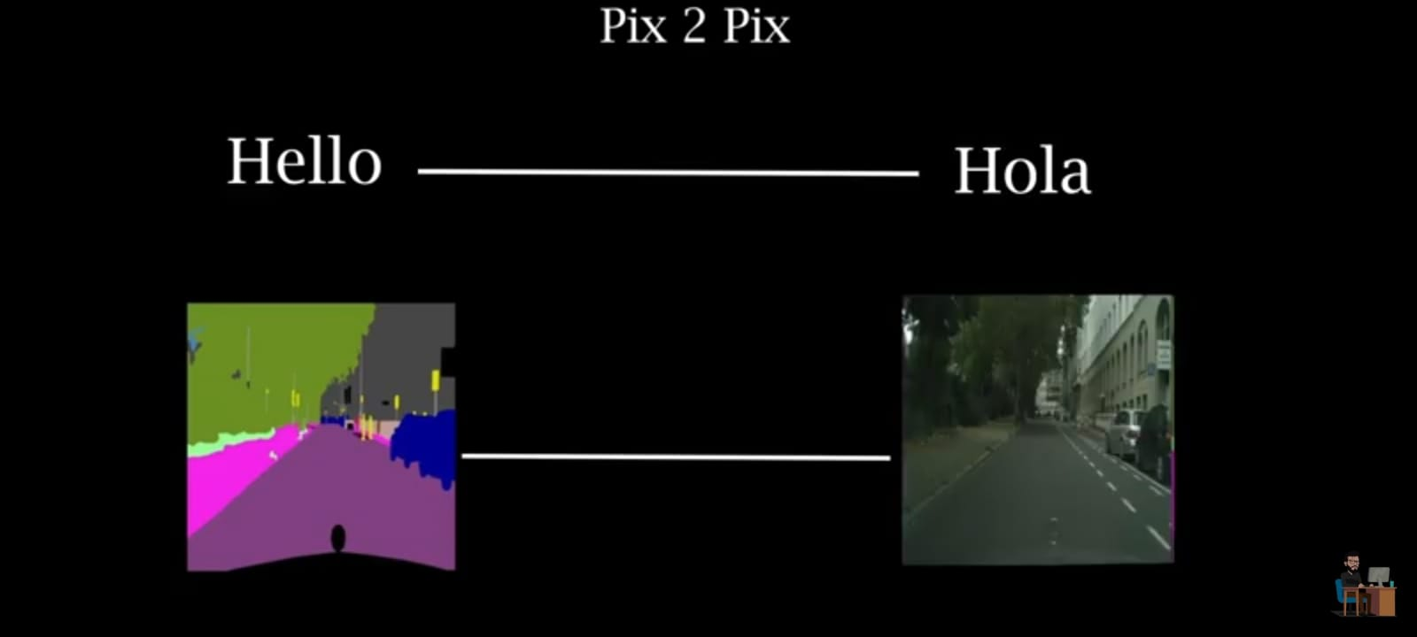
Pix2Pix

Slide 14
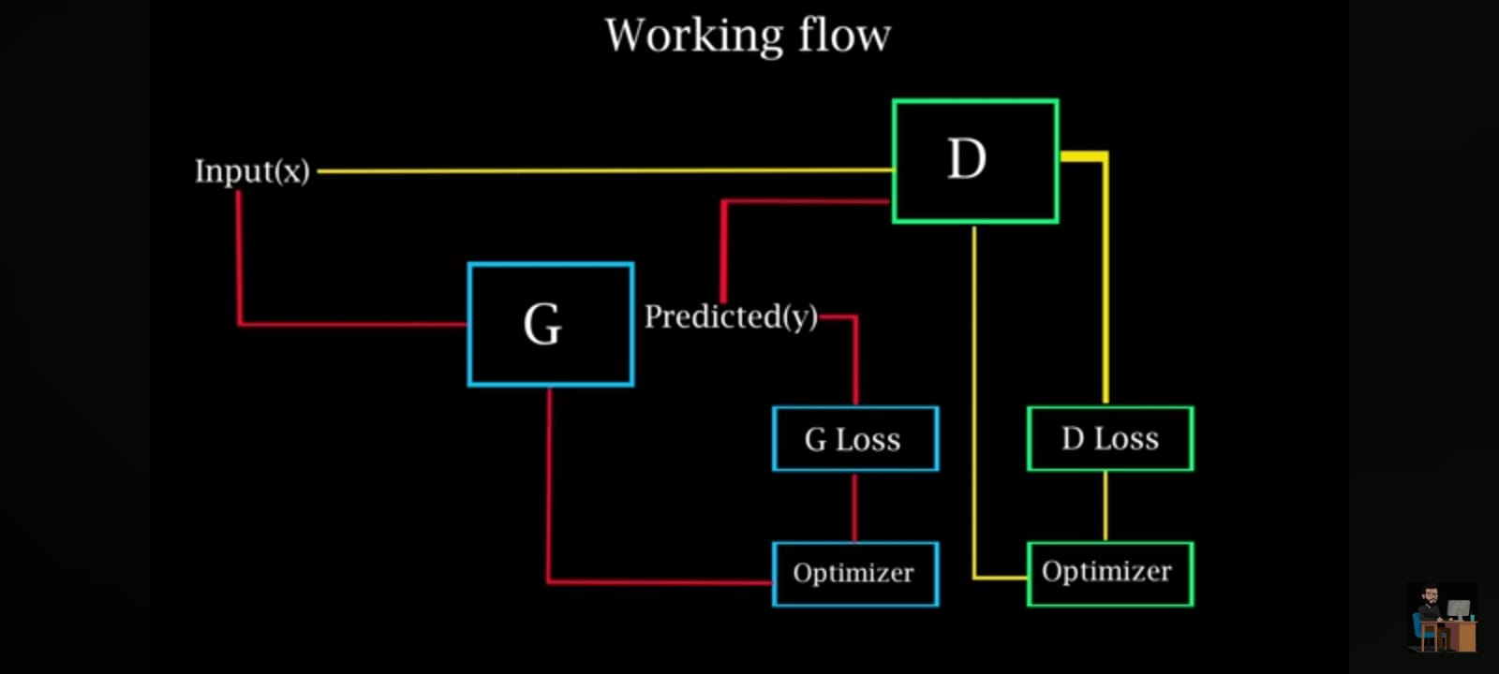
Architecture Of pix2pix

Slide 15
Generator
The generator takes an input image from one domain and tries to generate a corresponding image in the target domain. It typically consists of an encoder-decoder architecture,
often based on convolutional neural networks (CNNs). The encoder processes the input image and extracts features, while the decoder synthesizes the output image based on these features.

Slide 16

The Generator architecture (U Net)

Slide 17
Discriminator
The discriminator is a binary classifier (Patch GAN) that aims to distinguish between the synthesized images produced by the generator and the real images from the target domain. It helps in training the generator by providing feedback on how realistic its generated images are.

Slide 18
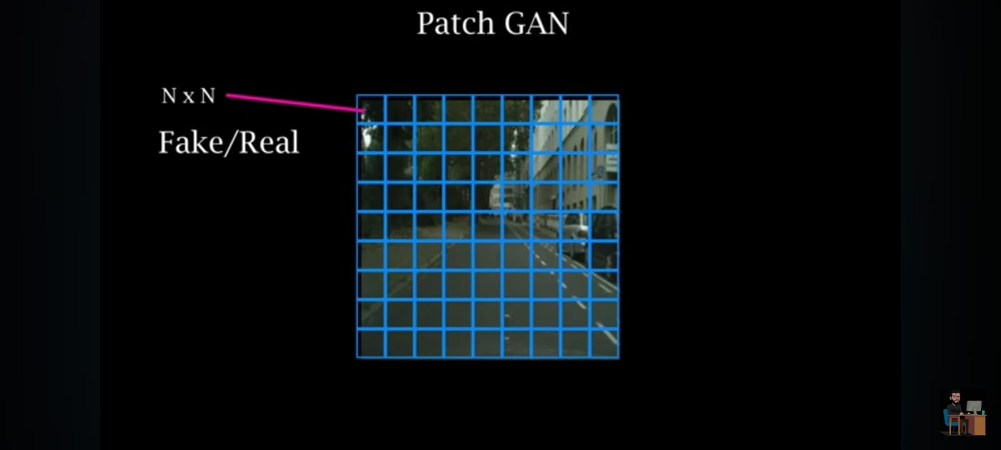
Patch Gan

Slide 19
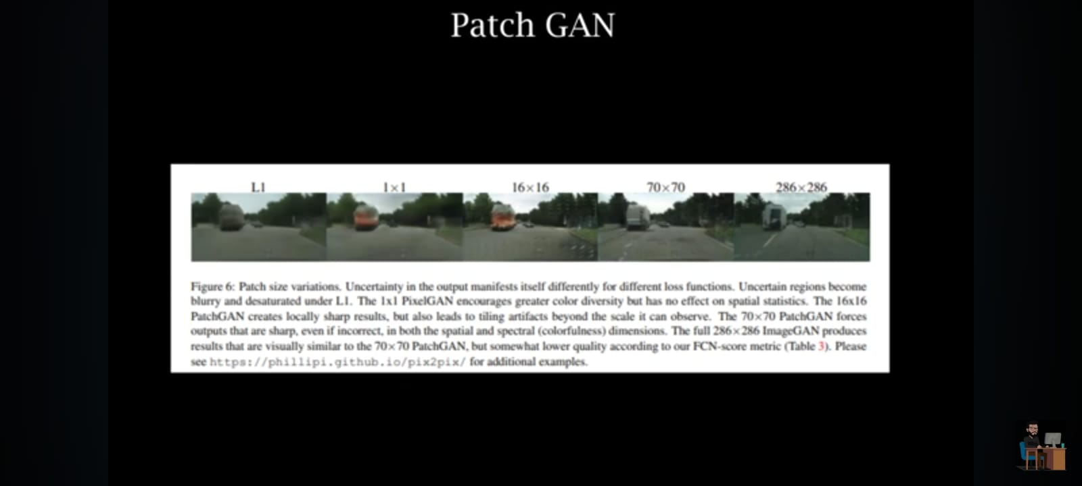

Slide 20
In Pix2Pix:
An image is input to the generator network, which then outputs a translated version.
The discriminator is a conditional discriminator, which is fed a real or fake (generated) image that has been conditioned on the same input image that was fed to the generator.
The goal of the discriminator is to classify whether the pair of images is real (from the dataset) or fake (generated).
The final objective of the Pix2Pix GAN remains the same as that of all the GANs. It too seeks to fool the discriminator, such that the generator learns to translate images perfectly.

Slide 21
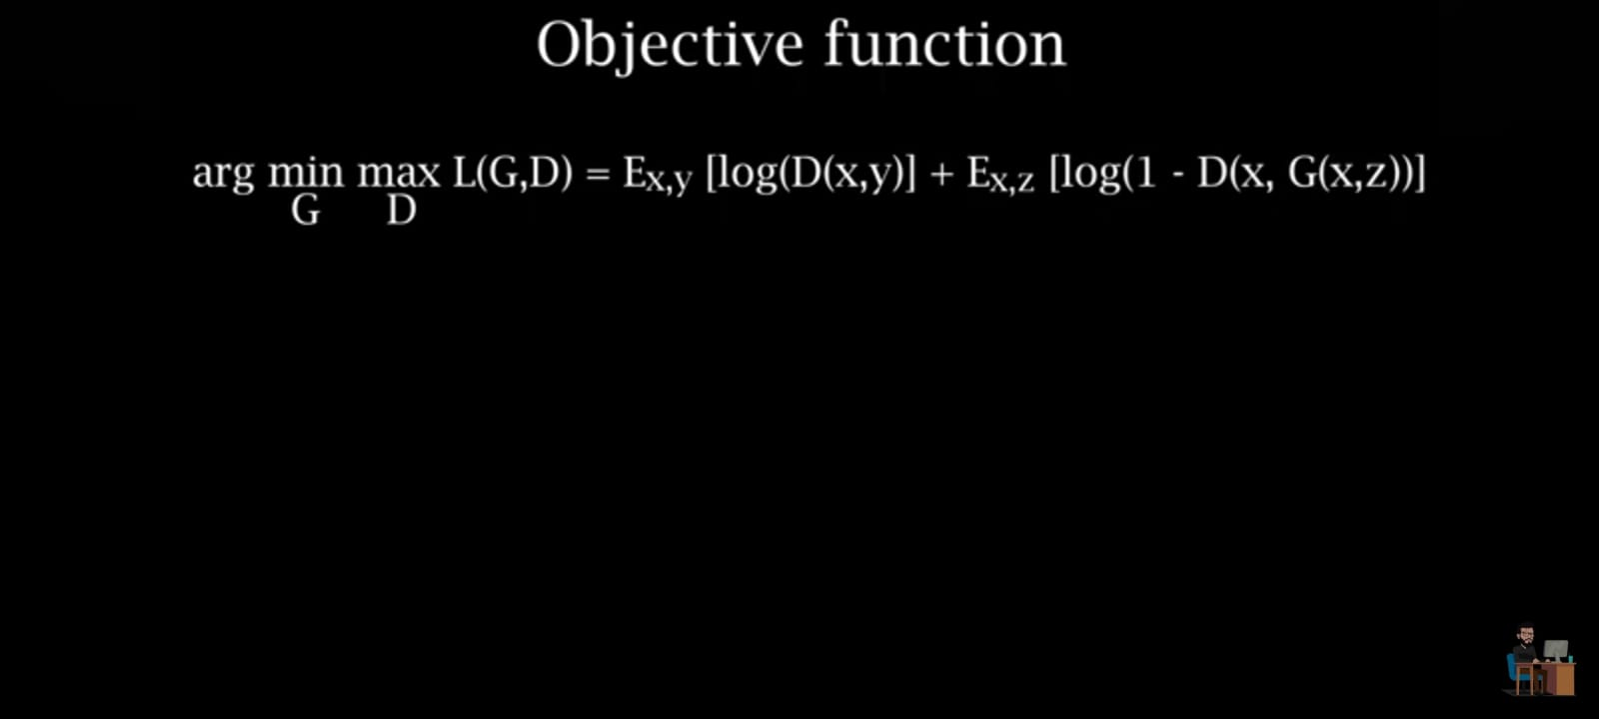
Loss Function

Slide 22
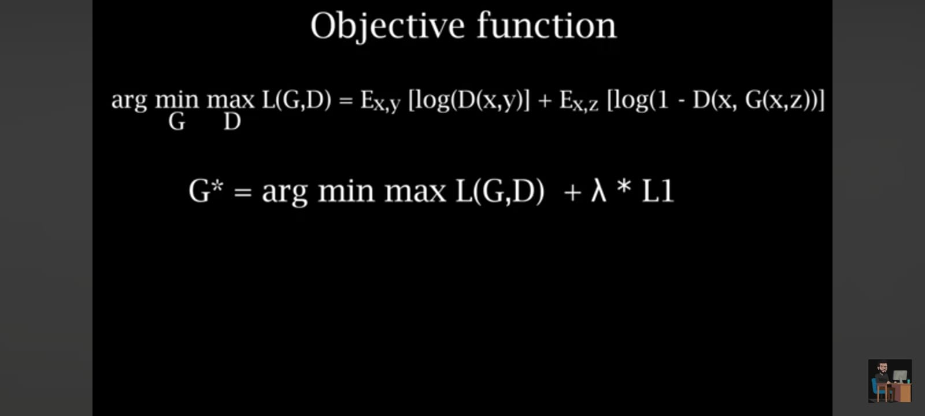
Loss Function PIX2pix

Slide 23
CycleGANs
Cycle GAN is a type of Generative Adversarial Network (GAN) architecture designed for unpaired image-to-image translation tasks. Unlike Pix2Pix, which requires paired data (each input image must have a corresponding target image), Cycle GAN can learn to translate images between two domains without explicit pairing of data.

Slide 24
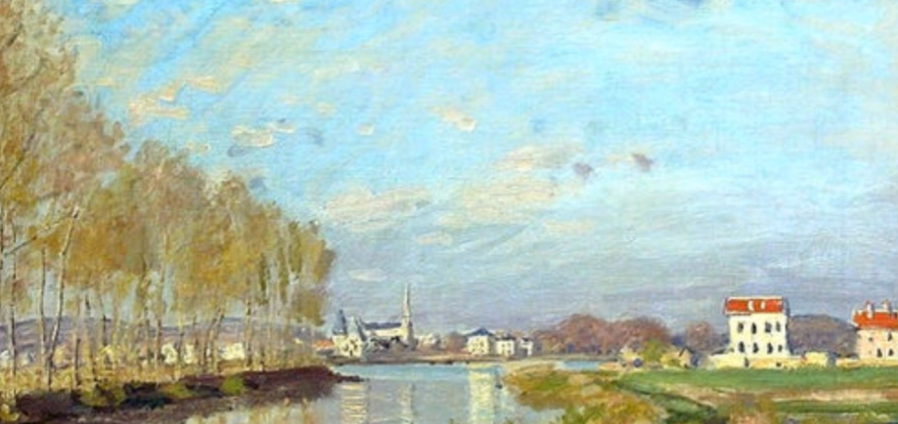

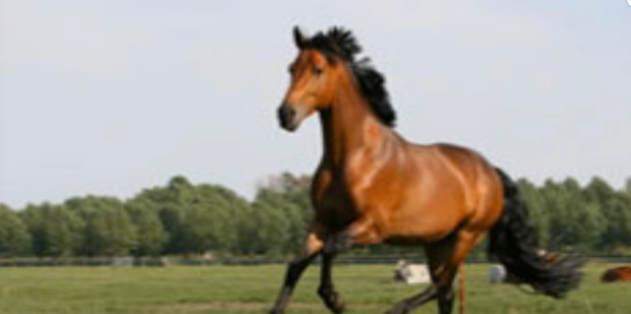

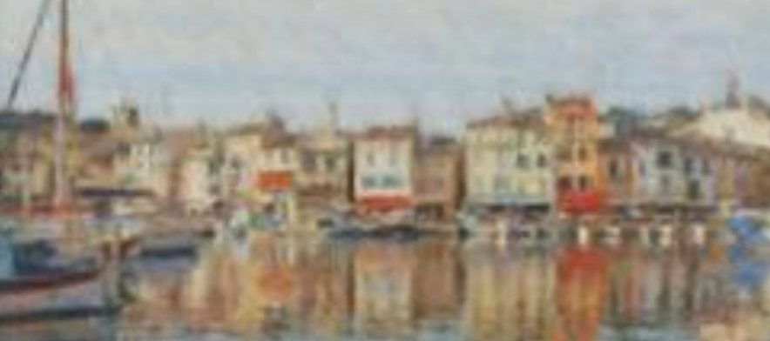
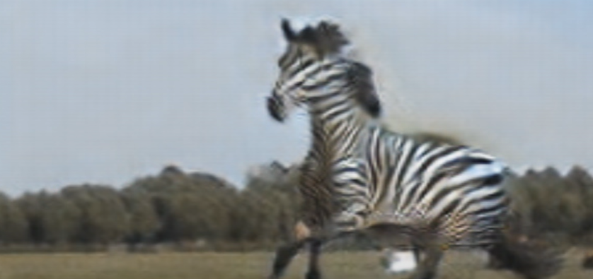
Examples

Slide 25
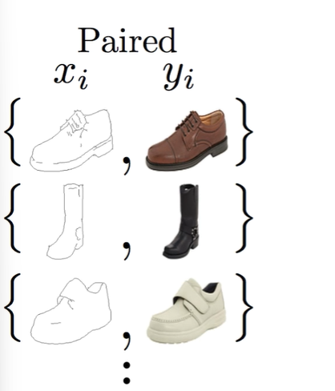
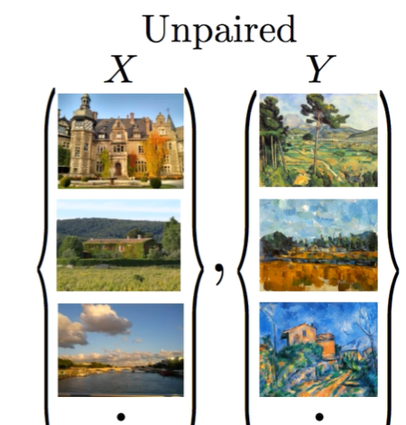
The problem with old GANs

Slide 26
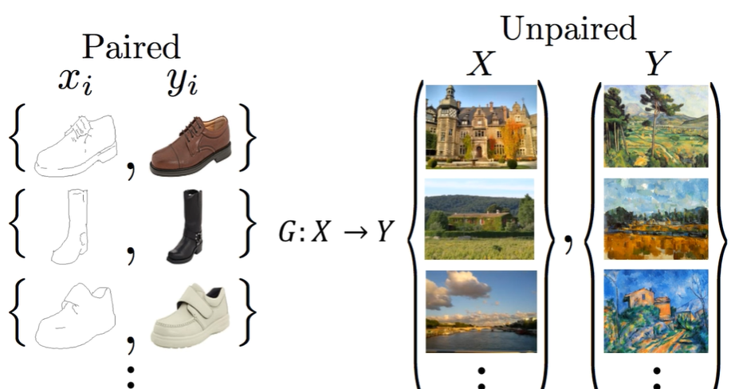
Our Goal To create a model learn this mapping ( G )

Slide 27
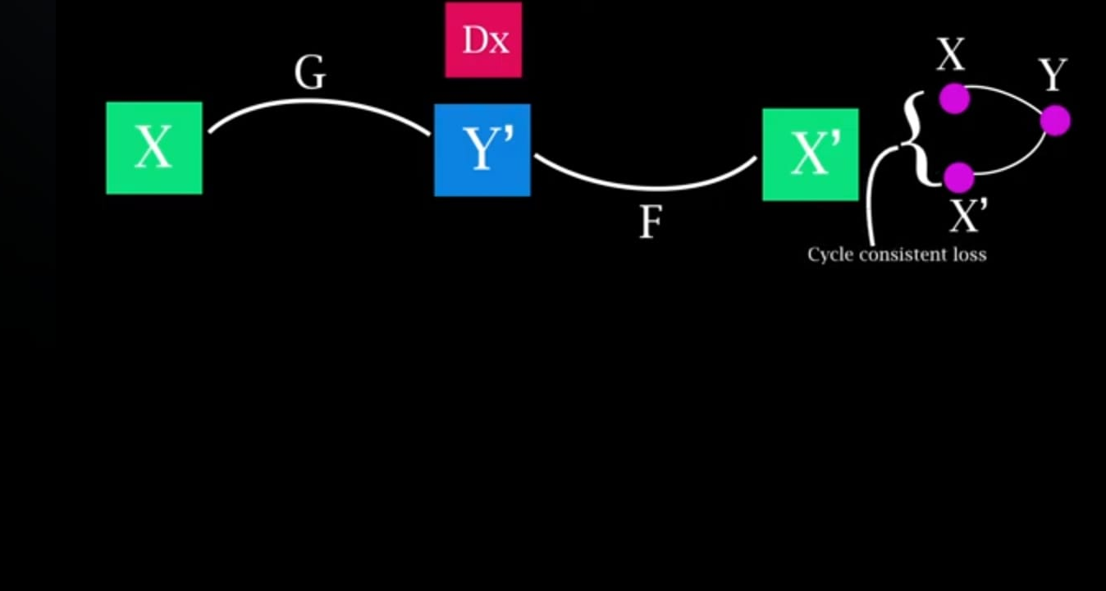

Slide 28
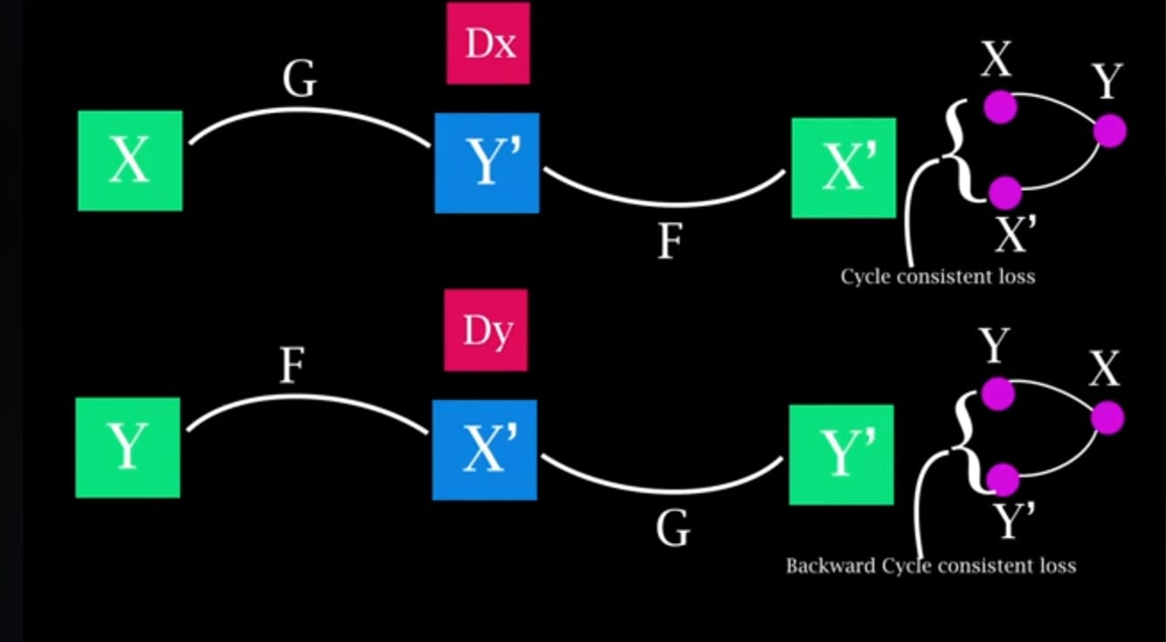

Slide 29
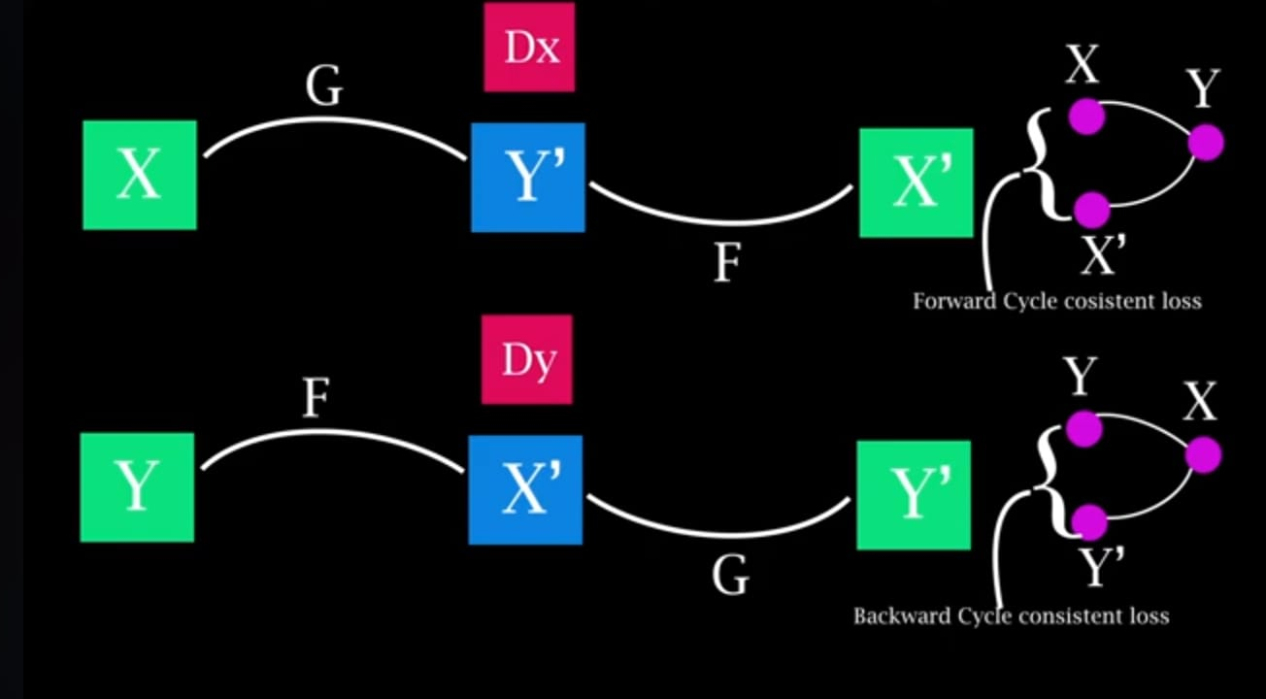

Slide 30
Cycle-Consistency:
The key idea behind Cycle GAN is the notion of cycle-consistency. Instead of directly mapping images from one domain to another, Cycle GAN introduces a cycle-consistency loss, which enforces that the reconstructed image (after going through both domain translations) should be similar to the original input image. This helps in preserving the content of the input image during translation.

Slide 31
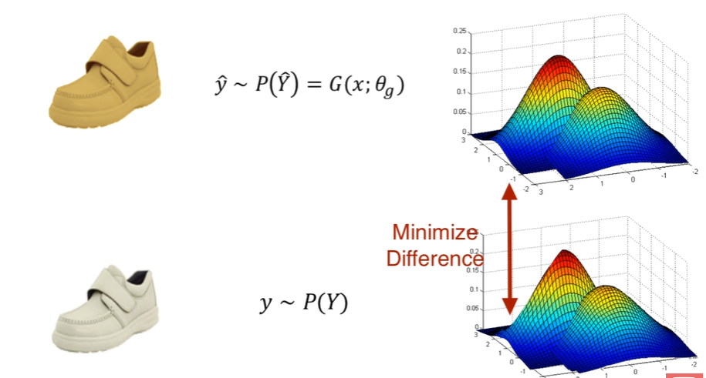
This is not enough

Slide 32
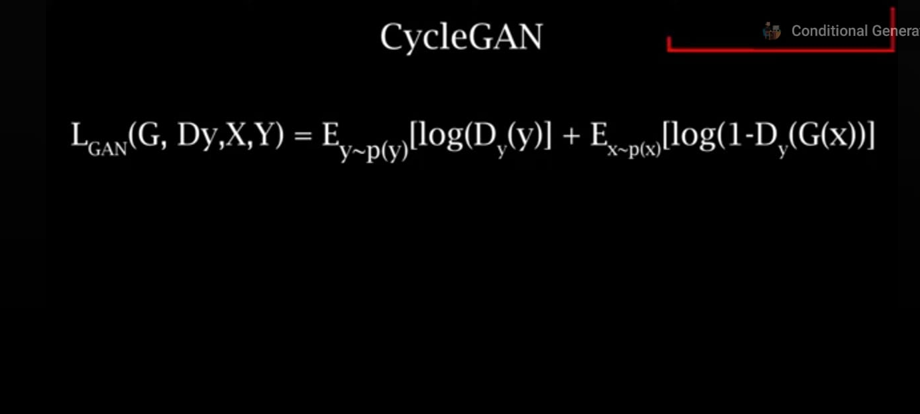


Slide 33
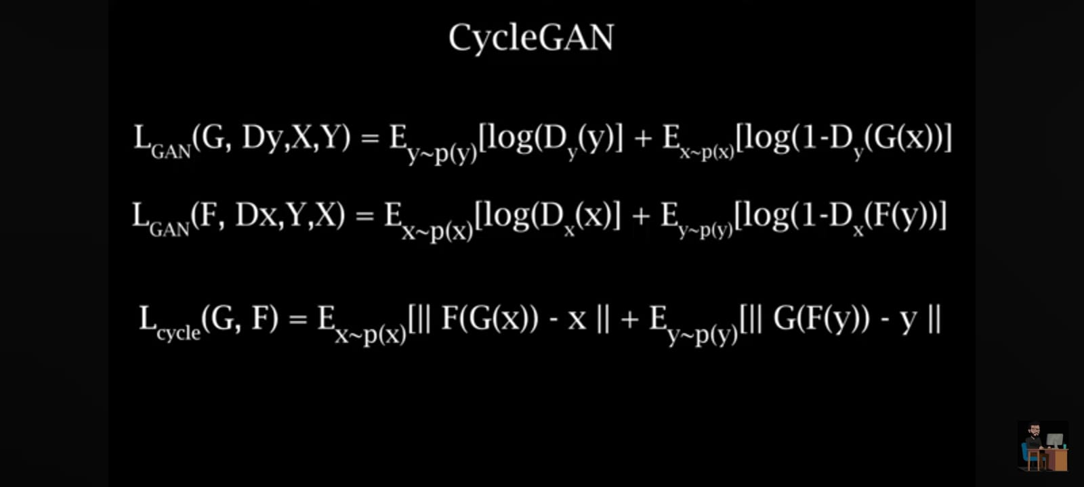

Slide 35
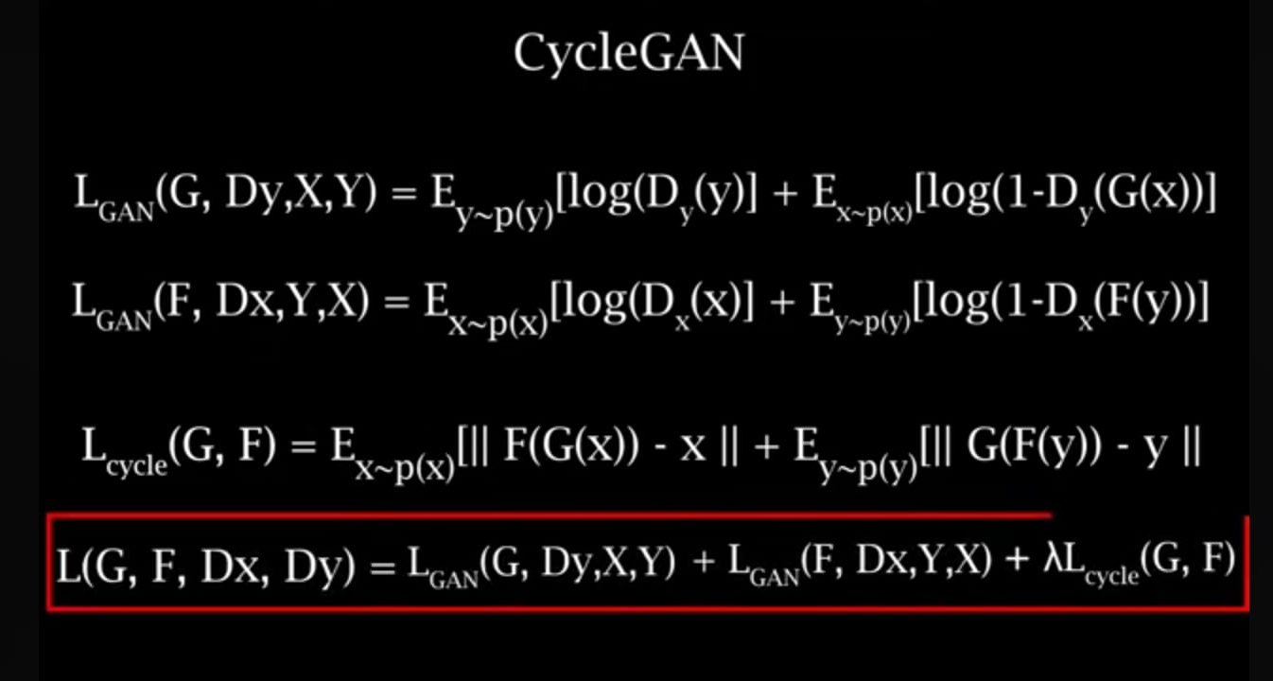

Slide 36
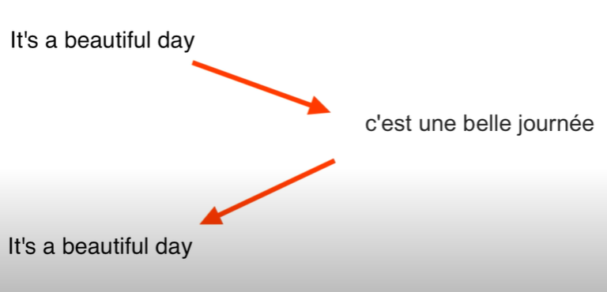
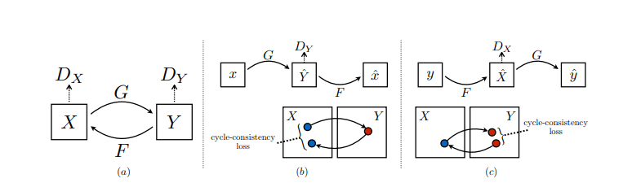
Architecture
The Cycle GAN architecture is different from other GANs in a way that it contains 2 mapping function (G and F) that acts as generators and their corresponding Discriminators (Dx and Dy): The generator mapping functions are as follows:

Slide 38
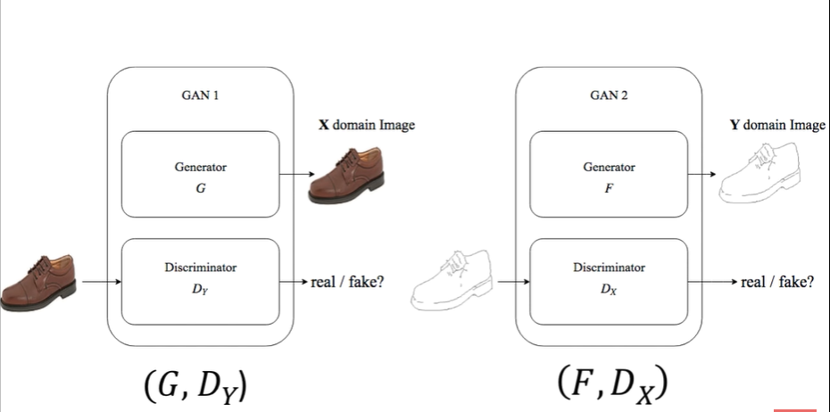
Two GANs

Slide 39
Thank you
Email : mabozithar@aiu.edi.eg

